Slide 1
Relational Model

Slide 2
Objectives
Terminology of relational model.
How tables are used to represent data.
Properties of database relations.
How to identify CK, PK, and FKs.
Meaning of entity integrity and referential integrity.
Purpose and advantages of views.

Slide 3
Relational Model
Introduced in E.F. Codd’s 1970 paper “A relational Model of the Data for Large Shared Data Banks” based on predicate logic and set theory.
Predicate logic, used extensively in mathematics, provides a framework in which an assertion (statement of fact) can be verified as either true or false.
Set theory is a mathematical science that deals with sets, or groups of things, and is used as the basis for data manipulation in the relational model.

Slide 4

Relational Database Model
3 main components
Data Structure (how data is represented)
Data-data diorganisasikan dalam bentuk table berdimensi dua dan yang terdiri atas baris dan kolom
Data integrity (what data is allowed)
Penentuan aturan-aturan bisnis dalam perusahaan yang diterapkan dalam database dengan tujuan menjaga integritas dan konsistensi data ketika dimanipulasi
Data manipulation (what you can do with the system)
Berkaitan dengan operasi untuk memanipulasi data (menambah, mengubah dan menghapus data)

Slide 5
Terminology
Relation A relation is a table with columns and rows.
Only applies to logical structure of the database, not the physical structure.
Attribute An attribute is a named column of a relation.
Domain A domain is the set of allowable values for one or more attributes.

Slide 6
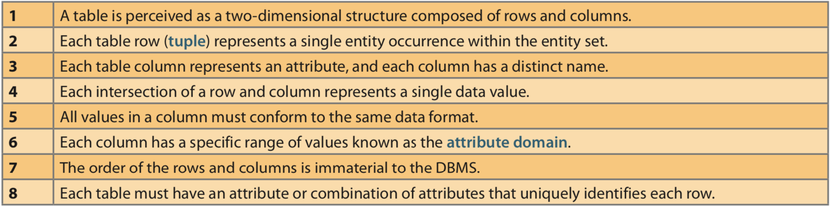
Table1 - Characteristics of a Relational Table

Slide 7
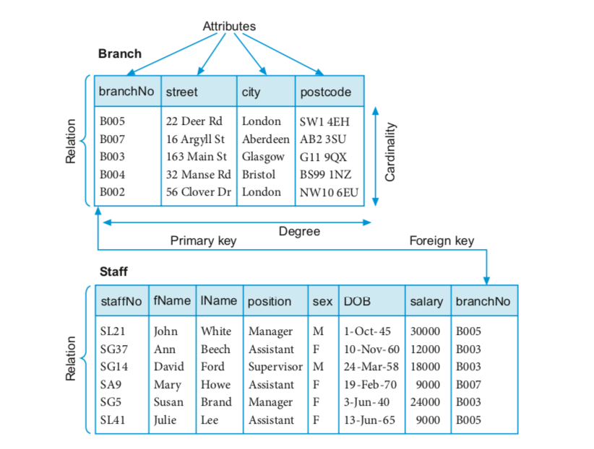
Instances of Branch and Staff Relations

Slide 8
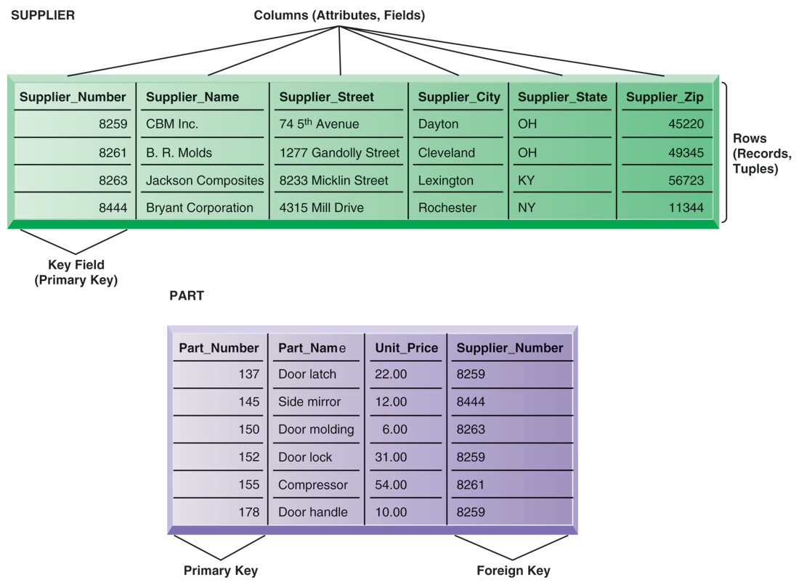
Relational Model

Slide 9
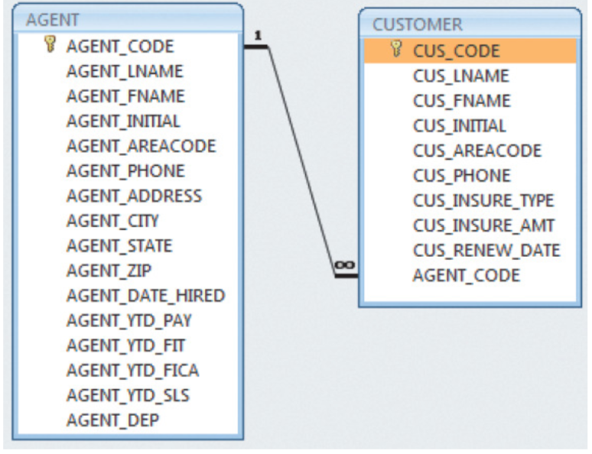
Figure 1 - A Relational Diagram

Slide 10
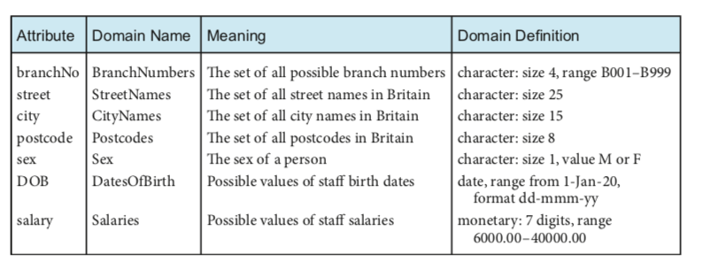
Examples of Attribute Domains

Slide 11
Terminology
Tuple A tuple is a row of a relation.
Degree The degree of a relation is the number of attributes it contains.
Cardinality The cardinality of a relation is the number of tuples it contains.
Relational database A collection of normalized relations with distinct relation names.

Slide 12
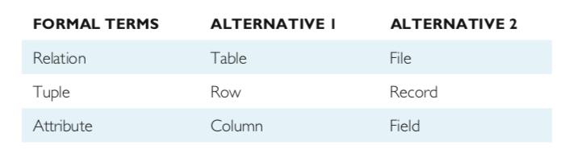
Alternative Terminology for Relational Model

Slide 13
Database Relations
Relation schema
Named relation defined by a set of attribute and domain name pairs.
Relational database schema
Set of relation schemas, each with a distinct name.

Slide 14
Properties of Relations
Relation name is distinct from all other relation names in relational schema.
Each cell of relation contains exactly one atomic (single) value.
Each attribute has a distinct name.
Values of an attribute are all from the same domain.

Slide 15
Properties of Relations
Each tuple is distinct; there are no duplicate tuples.
Order of attributes has no significance.
Order of tuples has no significance, theoretically.

Slide 16

Relational Keys
Superkey
An attribute, or set of attributes, that uniquely identifies a tuple within a relation.
Candidate Key
A superkey such that no proper subset is a superkey within the relation.
In each tuple of R, values of K uniquely identify that tuple (uniqueness).
No proper subset of K has the uniqueness property (irreducibility).

Slide 17
Relational Keys
Primary key
The candidate key that is selected to identify tuples uniquely within the relation.
Foreign Key
An attribute, or set of attributes, within one relation that matches the candidate key of some (possibly the same) relation.

Slide 18
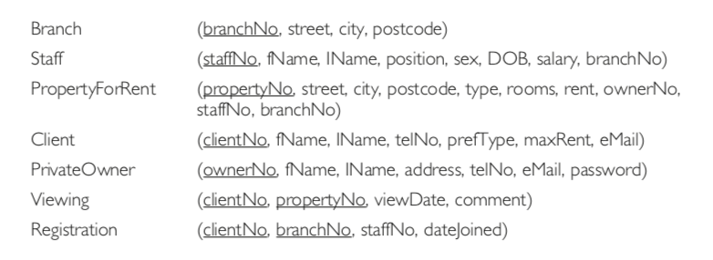
Relational Database Schemas

Slide 19
Relational Model
Advantages
Structural independence is promoted using independent tables
Tabular view improves conceptual simplicity
Ad hoc query capability is based on SQL
Isolates the end user from physical-level details
Improves implementation and management simplicity
Disadvantages
Requires substantial hardware and system software overhead
Conceptual simplicity gives untrained people the tools to use a good system poorly
May promote information problems

Slide 20

Relational Database Management System(RDBMS)
Performs basic functions provided by the hierarchical and network DBMS systems
Makes the relational data model easier to understand and implement
Hides the complexities of the relational model from the user

Slide 21
Integrity Constraints
Null
Represents value for an attribute that is currently unknown or not applicable for tuple.
Deals with incomplete or exceptional data.
Represents the absence of a value and is not the same as zero or spaces, which are values.

Slide 22
Integrity Constraints
Entity Integrity
In a base relation, no attribute of a primary key can be null.
Referential Integrity
If foreign key exists in a relation, either foreign key value must match a candidate key value of some tuple in its home relation or foreign key value must be wholly null.

Slide 23
Integrity Constraints
General Constraints
Additional rules specified by users or database administrators that define or constrain some aspect of the enterprise.

Slide 24
Integrity Rules
Entity Integrity | Description
Requirement | All primary key entries are unique, and no part of a primary key may be null
Purpose | Each row will have a unique identity, and foreign key values can properly reference primary key values
Example | No invoice can have a duplicate number, nor it can be null

Slide 25
Integrity Rules
Entity Integrity | Description
Requirement | A foreign key may have either a null entry or a entry that matches a primary key value in a table to which it is related
Purpose | It is possible for an attribute not to have a corresponding value but it is impossible to have an invalid entry It is impossible to delete row in a table whose primary keys has mandatory matching foreign key values in another table
Example | It is impossible to have invalid sales representative number

Slide 26
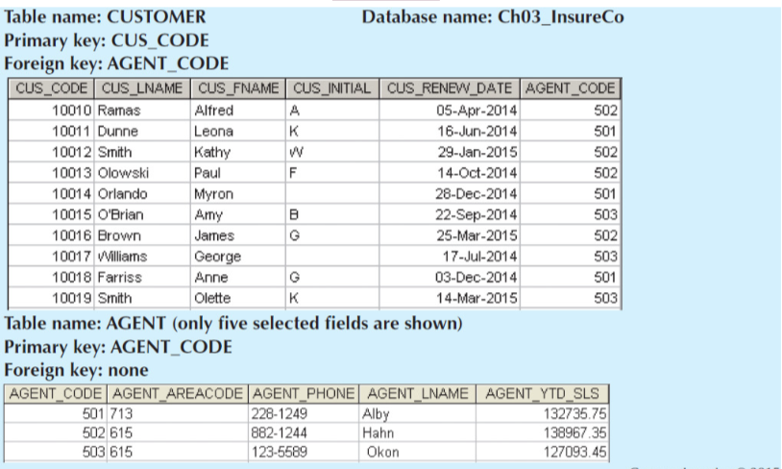
An Illustration of Integrity Rules

Slide 27
Ways to Handle Nulls
Flags: Special codes used to indicate the absence of some value
NOT NULL constraint - Placed on a column to ensure that every row in the table has a value for that column
UNIQUE constraint - Restriction placed on a column to ensure that no duplicate values exist for that column

Slide 28
Foreign Keys Example 2
dept_id is a candidate key for department
dept_id is a foreign key for employee - each dept_id value is either NULL or matches an entry in the department relation.

Slide 29
Foreign Keys Example 3
{stud_first, stud_last} is a candidate key for student - no entries have the same value for both stud_first and stud_last
{stud_first, stud_last} is a Foreign Key in enrolment - each stud_first,stud_last pair matches exactly one entry in the Student relation

Slide 30
Ways to Handle NullsReferential Integrity
When relations are updated, referential integrity can be violated
This usually occurs when a referenced tuple is updated or deleted
There are a number
RESTRICT - stop the user from doing it
CASCADE - let the changes flow on
NULLIFY - make values NULL
Triggers - actions defined by the user

Slide 31
Referential Integrity - Example
What happens if:
Marketing’s dept_id is changed to 16 in department?
The entry for Accounts is deleted from Department?

Slide 32
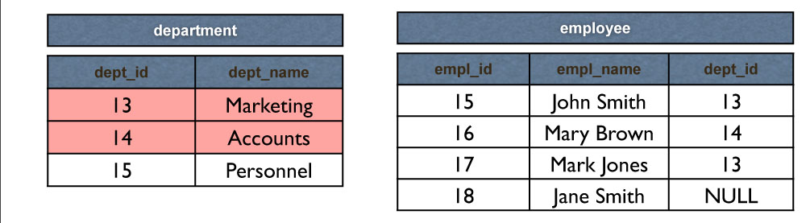
RESTRICT
RESTRICT stops any action that violates integrity
You cannot update or delete Marketing or Accounts
You can change Personnel as it is not referenced

Slide 33
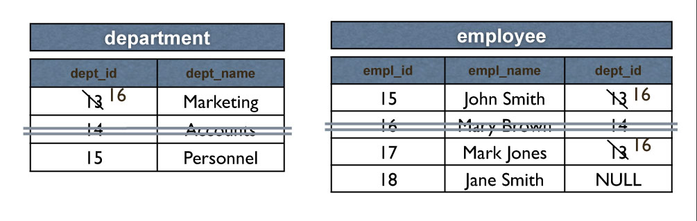
CASCADE
CASCADE allows the changes made to flow through
If Marketing’s dept_id is changed to 16 in department, then the dept_ids for John Smith and Mark Jones also change
If Accounts is deleted then so is Mary Brown

Slide 34
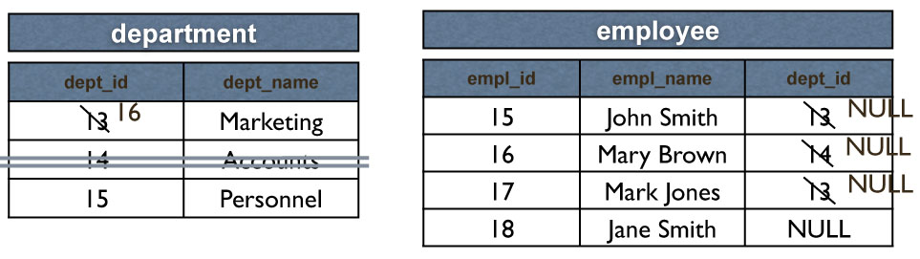
NULLIFY
NULLIFY sets problem values to NULL
If Marketing’s dept_id changes then John Smith’s and Mark Jones’ dept_ids are set to NULL
If Accounts is deleted, Mary Brown’s dept_id becomes NULL

Slide 35
Views
Base Relation
Named relation corresponding to an entity in conceptual schema, whose tuples are physically stored in database.
View
Dynamic result of one or more relational operations operating on base relations to produce another relation.

Slide 36
Views
A virtual relation that does not necessarily actually exist in the database but is produced upon request, at time of request.
Contents of a view are defined as a query on one or more base relations.
Views are dynamic, meaning that changes made to base relations that affect view attributes are immediately reflected in the view.

Slide 37
Views
A virtual relation that does not necessarily actually exist in the database but is produced upon request, at time of request.
Contents of a view are defined as a query on one or more base relations.
Views are dynamic, meaning that changes made to base relations that affect view attributes are immediately reflected in the view.

Slide 38
Purpose of Views
Provides powerful and flexible security mechanism by hiding parts of database from certain users.
Permits users to access data in a customized way, so that same data can be seen by different users in different ways, at same time.
Can simplify complex operations on base relations.

Slide 39
Updating Views
All updates to a base relation should be immediately reflected in all views that reference that base relation.
If view is updated, underlying base relation should reflect change.

Slide 40
Updating Views
There are restrictions on types of modifications that can be made through views:
Updates are allowed if query involves a single base relation and contains a candidate key of base relation.
Updates are not allowed involving multiple base relations.
Updates are not allowed involving aggregation or grouping operations.

Slide 41
Updating Views
Classes of views are defined as:
theoretically not updateable;
theoretically updateable;
partially updateable.

